Slide 1
Capstone Project
Project Title HOTEL BOOKING ANALYSIS by Sudhanshu Chouhan
Kapil Narayan Singh
Nimisha Nooti

Slide 2

PROBLEM STATEMENT
Hotel Industry is the backbone of tourism sector. Revenue of the hotel industry depend upon multiple factors.
Some of the factors influence the hotel business are Location, Quality Management, Flexibility, Global Outlook etc.
In order to understand how guest select hotels to stay in and what are decision making factors that prevail, this analysis will help us to target the important area and generating more revenue for the hotel industry.

Slide 3
Road Map of Data Analysis
Basic cleaning : Separating the required data from the data set to use it for analyzing.
Understanding and analyzing the factors effecting the booking : Factors like seasons, festivals and holidays effect the data.
Data processing : We’ll go through each and every feature and encoded the categorical features. Changed the columns according to requirement of analysis.
visualizing the test assumptions : We'll check if our data meets the assumptions required by most multivariate techniques, and represent them in the understandable-form of visualization using bar, pie, line, box etc plots

Slide 4

Data Description
There are 119390 rows and 32 columns in the given data set.
From the variables we will evaluate the dependency of hotel booking as follows:
Hotel wise analysis
Booking cancellation analysis
Bookings based on Meals, Countries, Room Type
Distribution channel wise analysis
Lead time analysis
Revenue analysis
Bookings over time analysis

Slide 5

Data Summary
lead_time
arrival_date_year
arrival_date_week_number
arrival_date_day_of_month
stays_in_weekend_nights
stays_in_week_nights
adults
children
babies
is_repeated_guest
booking_changes
agent
company
adr
total_of_special_requests
Binary
is_cancelled
repeated_guest
Numeric
hotel
arrival_date_month
meal
country
market_segment
distribution_channel
reserved_room_type
assigned_room_type
deposit_type
customer_type
reservation_status
categorical

Slide 6
Let's first describe the Variables.
1. Hotel : Two category of hotels are Resort Hotel or City Hotel.
2. is_canceled : Value indicating if the booking was canceled ()1 or not(0)
3. lead_time : Number of days that elapsed between the entering date of the booking into the PMS and the arrival date.
4. arrival_date_year : Year of booking arrival date .
5. arrival_date_month : Month of booking arrival date.
6. arrival_date_week_number : Week number of the booking arrival date.
7. arrival_date_day_of_month : Day of booking arrival date.
8. stays_in_weekend_nights : Number of weekend nights(Saturday or Sunday) the guest stayed or booked to stay at the hotel.
9. stays_in_week_nights : Number of week nights(Monday or Friday) the guest stayed or booked to stay at the hotel.
10. adults : Number of adults reserved the hotel stay.

Slide 7
Describing Variables continued….
11. children : Number of children.
12. babies : Number Of babies.
13. meal : kind of meal opted for.
14. country : Country code.
15. market_segment : Market segment designation .
16. distribution_channel : Booking distribution channel.
17. is_repeated_guest : Is a repeated guest is binary info (1) yes or (0) no.
18. previous_cancellations : Number of previous cancellation not cancelled by current booking.
19. previous_bookings_not_canceled : Number of previous booking not cancelled by current booking.
20. reserved_room_type : Code of room type reserved.
21. assigned_room_type : Code for the type of room assigned.
22. deposit_type : No deposit, Non Refund, Refundable

Slide 8
Describing Variables continued….
22. booking_changes : Number of changes made to the booking from the moment PMS until the moment of check in/cancellation.
24. Agent : ID of the travel agency that made the booking.
25. Company : ID of the company/entity that made the booking.
26. days_in_waiting_list : Number of days the booking was in the waiting list before it was confirmed to the customer.
27. customer_type : Type of customer. contact, group, transient, transient party.
28. adr : Average daily rate as defined by dividing the sum of all lodging transaction by the total number of staying nights.
29. required_car_parking_spaces : Is parking required.
30. total_of_special_requests : Number of additional special requirement.
31. reservation status : status of reservation
32. reservation_status_date : Date of the specific status.

Slide 9
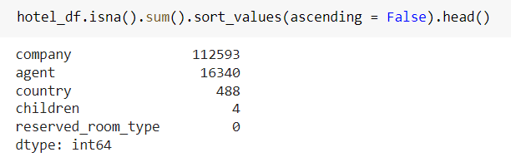
Data Cleaning and Manipulation
Finding the null values in column:
To Identify the null values in the columns of data set we are using ‘isna()’ method. We can see that the columns – [company , agent, country and children] have null values in decreasing order respectively rest of the data don't have any missing value.

Slide 10
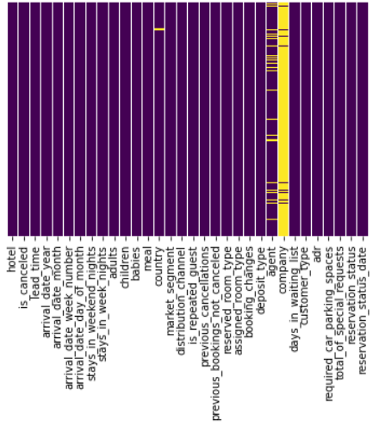
Heat map showing null values:
This heat map shows the column company has highest null values. The color difference (yellow color) shows the null values in that column.

Slide 11

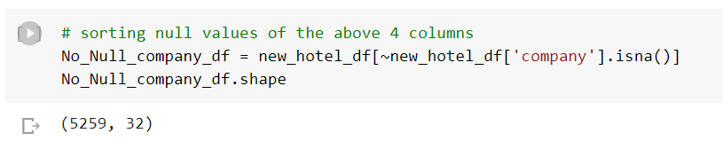
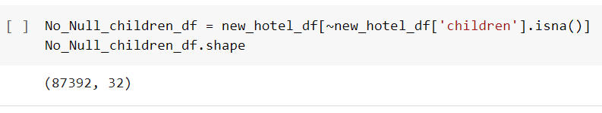
Now we will find out duplicate values in the dataset using ‘drop()’ method
Removing the duplicate values in the data set:
There are 31994 duplicate values found in the data set.
Removing the null values in the columns of data set:
When ever we are working with above 4 columns of data set we will use
'no_null_df' to eliminate the null values.

Slide 12
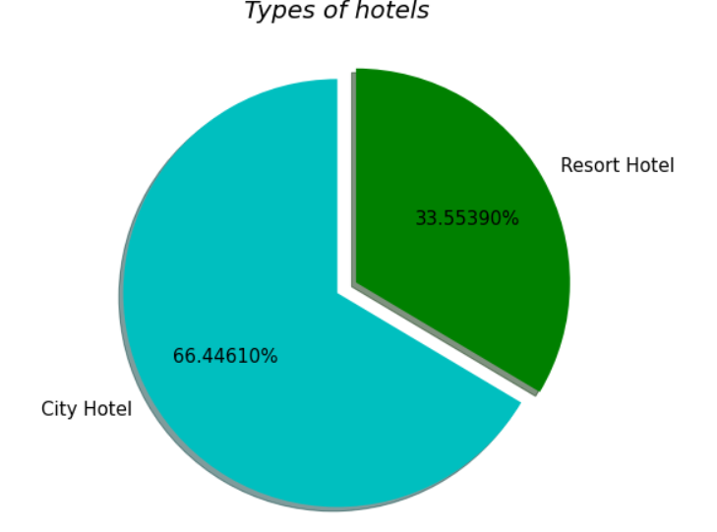
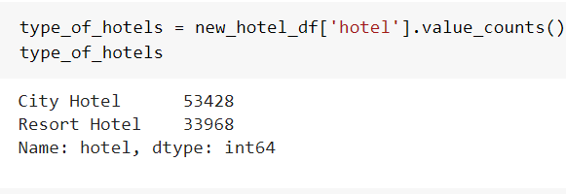
Data Visualization
After data cleaning and manipulation we will visualize our data set through various visualization techniques and discuss about various conclusion we will get from mentioned techniques.
There are 66.4% of City Hotels and 33.5% of Resort Hotels were booked. Therefore City Hotels are more preferred by guests compared to Resort hotels.

Slide 13
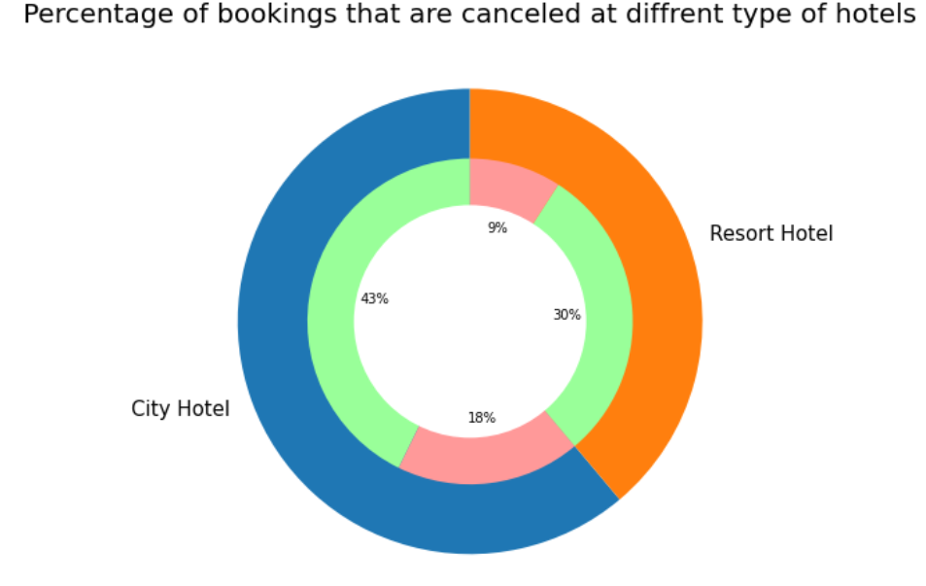
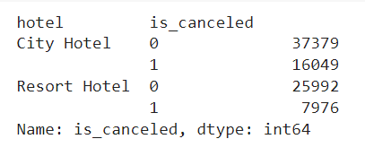
we can observe from the above pie visualization that the max bookings and cancellations are happening in city hotel.
total bookings that are cancelled = (18%+9%) = 27% ( 66.6% of cancellation happening in city hotel)
total bookings that are not cancelled = (43%+30%) = 73%
green = bookings not cancelled
pink = bookings cancelled

Slide 14
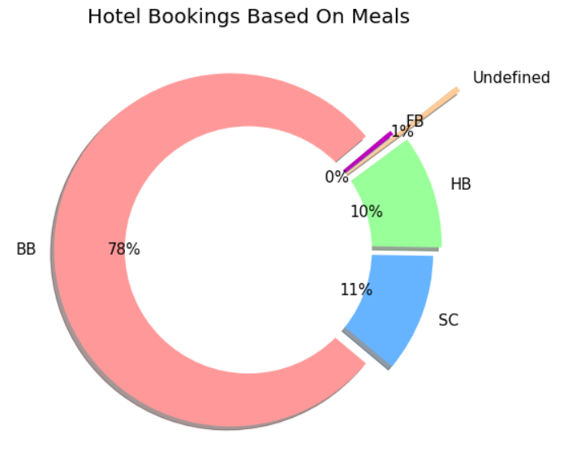
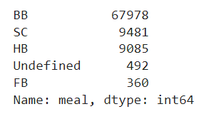
Hotel Bookings based on Meals
RO: Room only
BB: Bed & Breakfast
HB: Half Board (Breakfast and Dinner normally)
FB: Full Board (Breakfast, Lunch and Dinner)
AI: All Inclusive (all services of full board plus any others specified in each case)
From the above pie visualization we can conclude that 78% of Hotel Bookings are happening on 'BB' meal type i.e., 'BB: Bed & Breakfast‘.

Slide 15
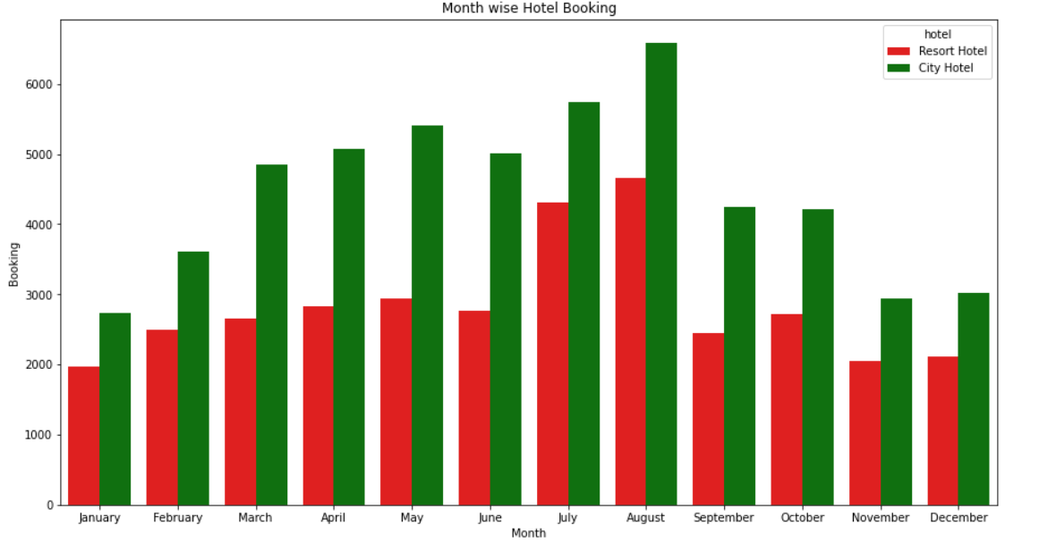
Most of the city and resort bookings are happening in the month of August followed by July. Least bookings are happening in the month of January, November and December.

Slide 16
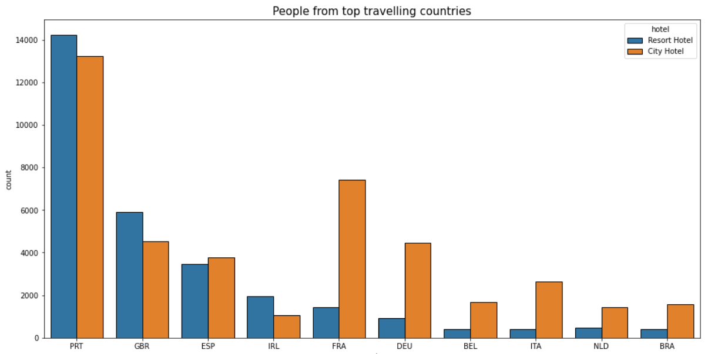
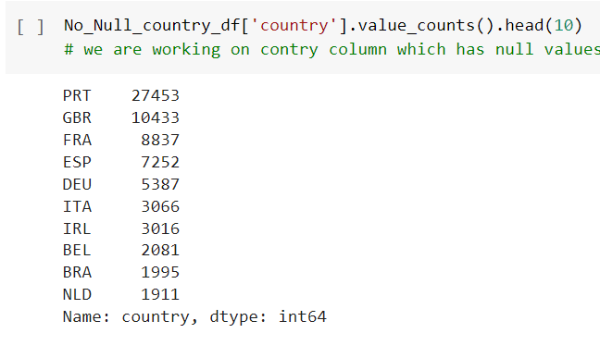
Booking analysis based on countries
From the above bar chart visualization we can notice that most of the hotel bookings are happening in "PTR(Portugal)" country. we can also observe that the maximum people are preferring city hotels compared to Resort Hotels.

Slide 17
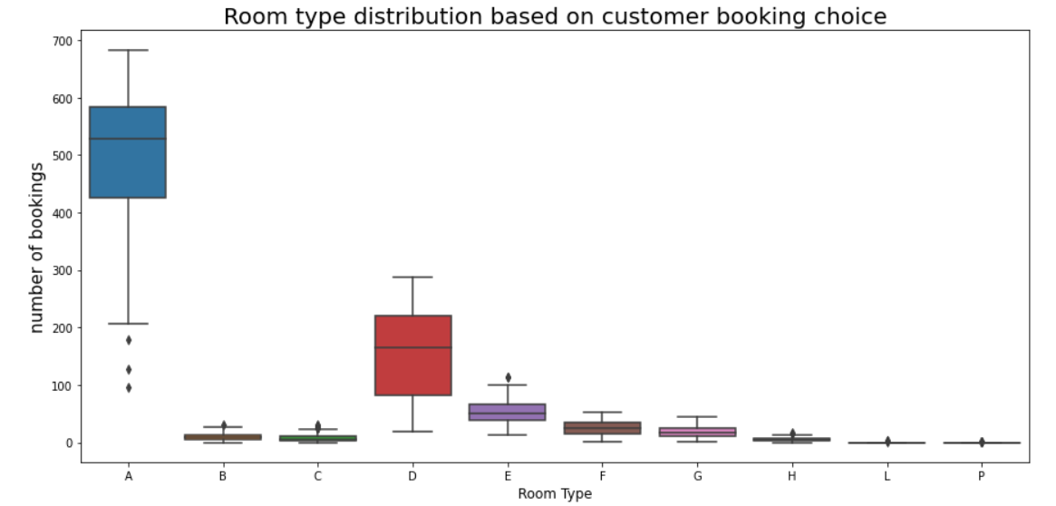
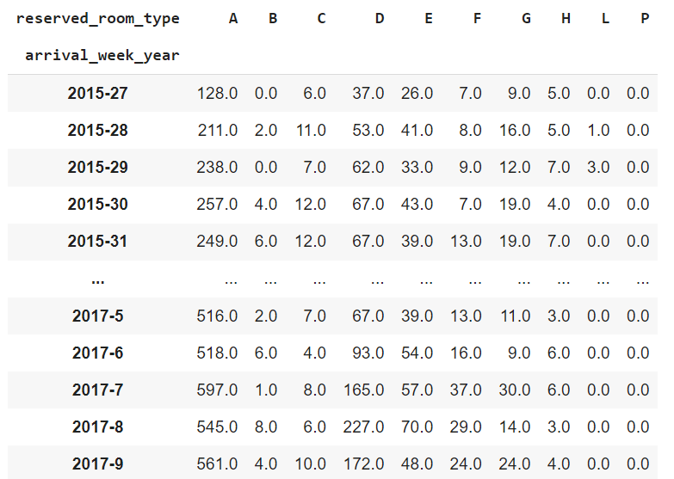
Demand of Room Types with respect to weeks of years(2015-17):
Most demanded room types are A next comes D and least bookings are done for room type P and L.

Slide 18
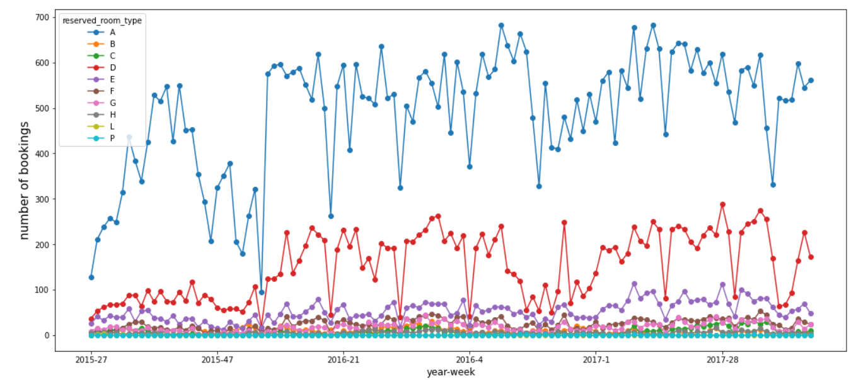
Maximum bookings were happened in 9th and 12th week of every year.

Slide 19
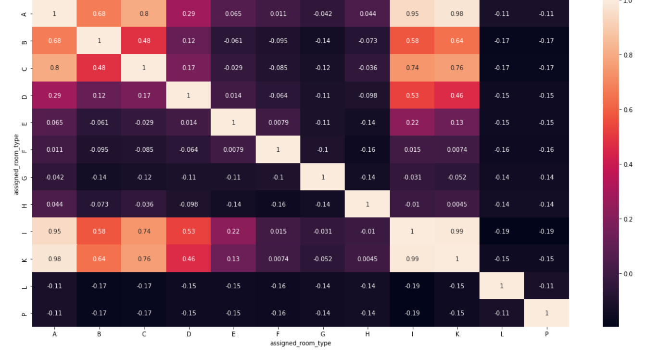
The possibility of getting the reserved room type
The lighter color indicates the more probability of getting the reserved type of room and the darker color indicates the less/no probability of getting the room of customer choice.
Probability of room allocation for the customer choice
reserved type A is in the
order - A, K, I, C, B.

Slide 20
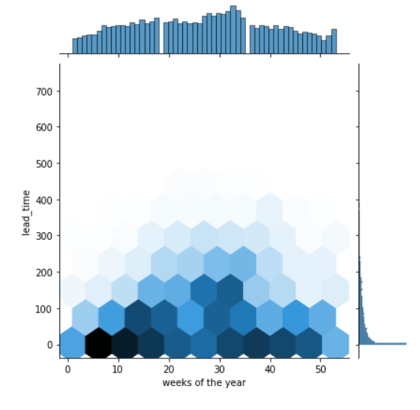
Analyzing Lead Time Of Bookings
The bar plots represents max bookings done in the weeks in X-axis i.e., (max bookings done b/w week 30 to 35) and max lead_time taken for booking in Y-axis i.e., (max lead time taken is 0-immediate booking).
Hex plot represents max lead time taken in the b/w 11th - 18th weeks of the year.

Slide 21
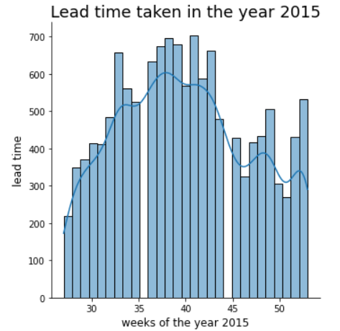
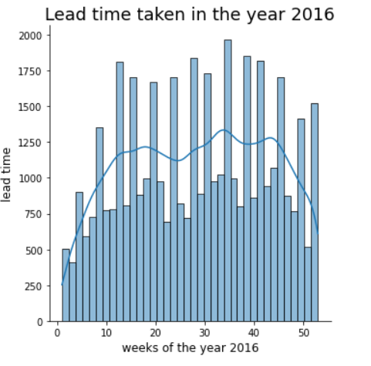
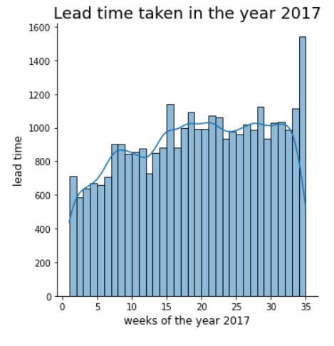
Analysis of lead time year by year
From the above displot analysis we can conclude that maximum lead time taken in bookings are in the year 2016. ‘UEFA Euro 2016 Final’ held in France may be the one of the reason of prior booking of hotels happened with high Lead Time.

Slide 22
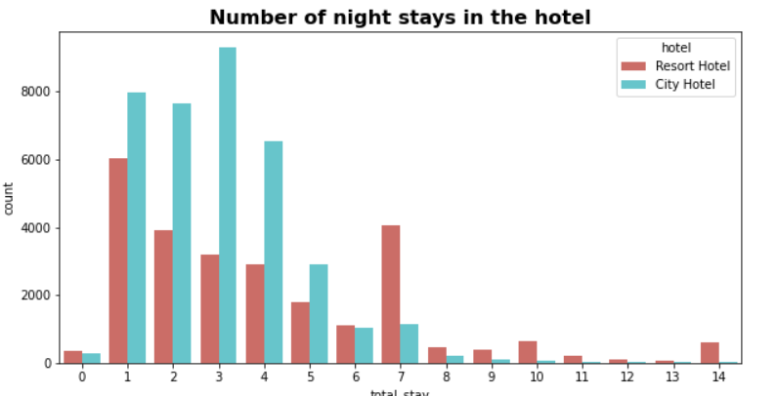
Number of days people stay in the hotel
We can notice that majority of people stay or do a booking of ‘7’ or less than ‘7’ days.
Maximum night bookings are happening in the city hotels and the max length of stay is
‘3’ days.
Maximum night bookings length of stay happening in the Resort Hotel are for one night stay.
We can also observe that if the stay is longer than 7 days then guests are preferring to book Resort Hotels only.

Slide 23
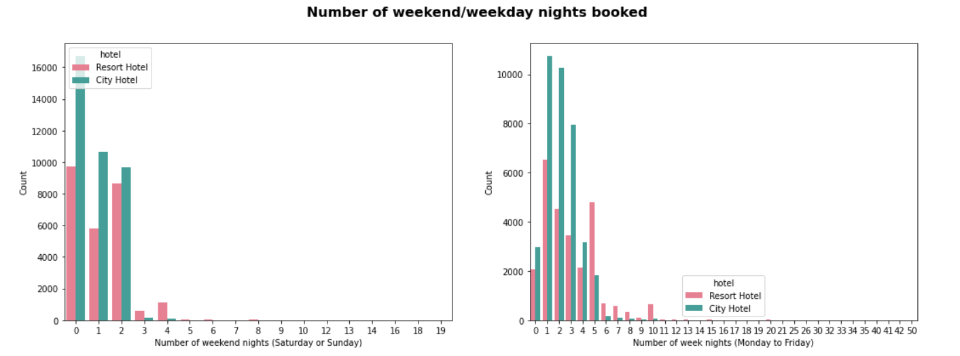
We can see that majority of people stay or do a booking of 5 or less than 5 days. Now, we can say the optimal length of stay to get best daily rate is '5' for week nights and '2' for weekend nights.
max night bookings are happening in the city hotels in weekdays and the max length of stay is 1 to 2 days.

Slide 24
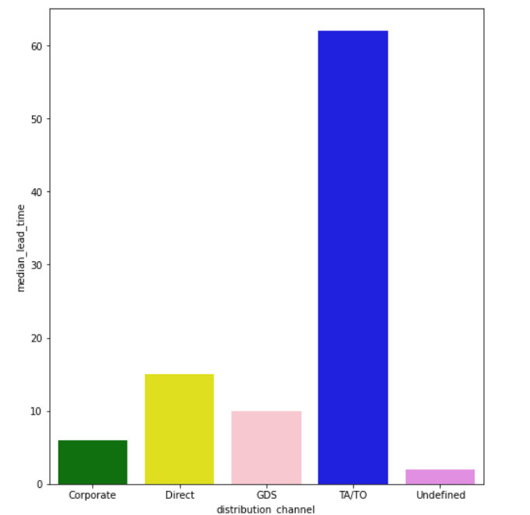
Analyzing on the basis of distribution channel
Distribution channel v/s median lead time:
Distribution channel is the costumer accessed by corporate booking/Direct/Travel agent(TA).Travel operator(TO) and Median lead time is the median of number of days that elapsed between the entering date of the booking into the PMS and arriving date.
Through TA/TO distribution channels, bookings were with high lead time i.e., they are booking early compare to other distribution channels.

Slide 25
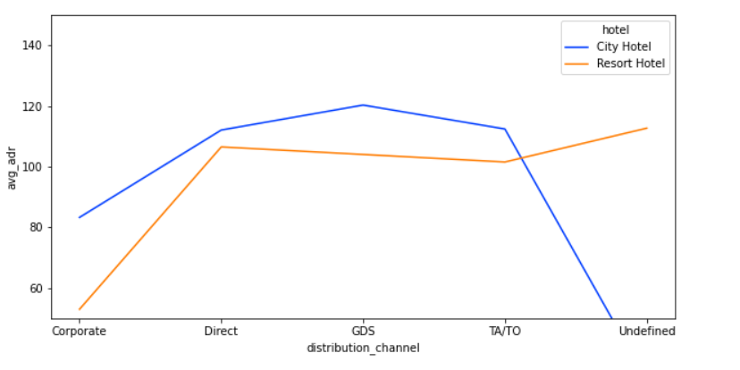
ADR(Average daily rate) generated through various distribution channels
Average daily rate (ADR), one of the three key hotel performance indicators (along with occupancy and Revenue per available room(RevPAR)), is the measure of the average paid for rooms sold in a given time period. The metric covers only revenue-generating guestrooms.
How to calculate ADR:
ADR is calculated by dividing room revenue by rooms sold. The metric is of course applicable for any currency.
ADR = Room Revenue/Rooms Sold
As ADR is the revenue determining factor 'GDS distribution channel' of city hotel bookings are achieving high adr (revenue).

Slide 26
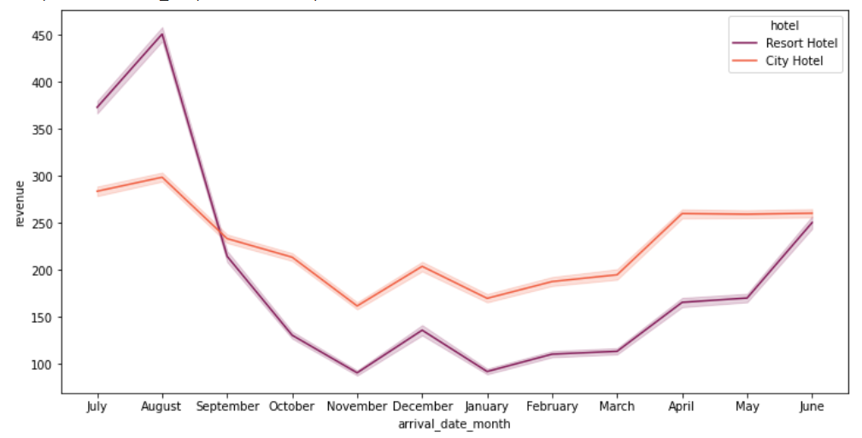
Average Revenue of the Hotel
ADR = Room Revenue/Rooms Sold
Room Revenue = ADR * Rooms Sold
Avg Room Revenue = mean ADR * mean Rooms Sold
From the above analysis we can notice that the Resort hotels are getting highest revenue in the month of 'august', 'july' and then decreases drastically. City hotel's revenue is almost constant all over year.

Slide 27
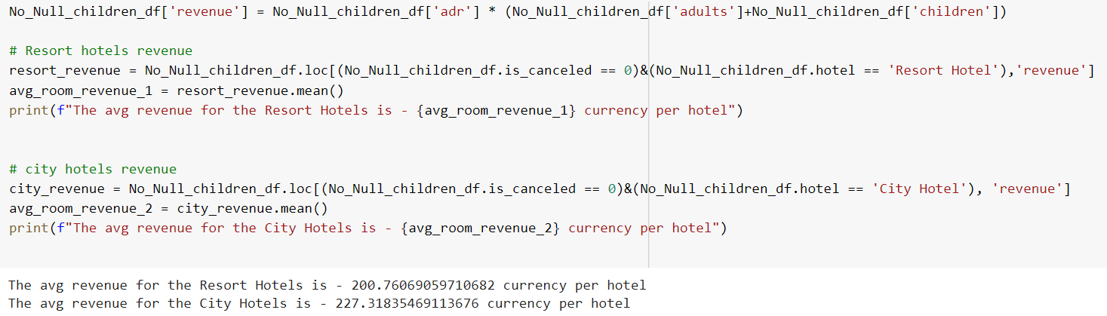
Average Revenue of the hotels from 2015-17 is calculated as follows:
Rooms sold are calculated based on no. of booking i.e., no. of adult bookings+ no. of children bookings

Slide 28
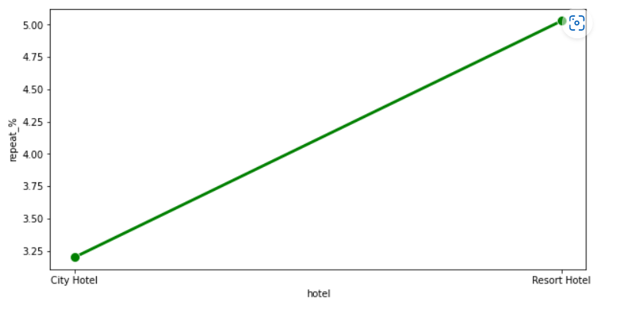
Chances of customer will return
There is a very less probability that the customer will repeat. But the return percentage of resort is slightly greater than that of city hotel.

Slide 29
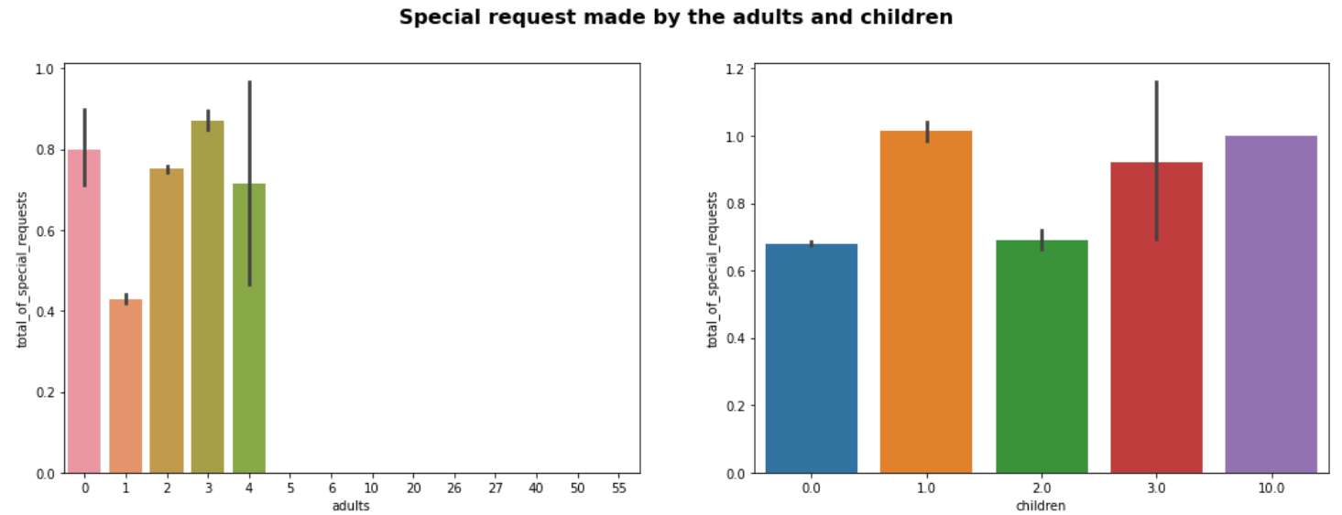
We can see that if the adults are more than 2, there are high chances that the hotel receives more special requests and the no. of special requests for children has no much variation.

Slide 30
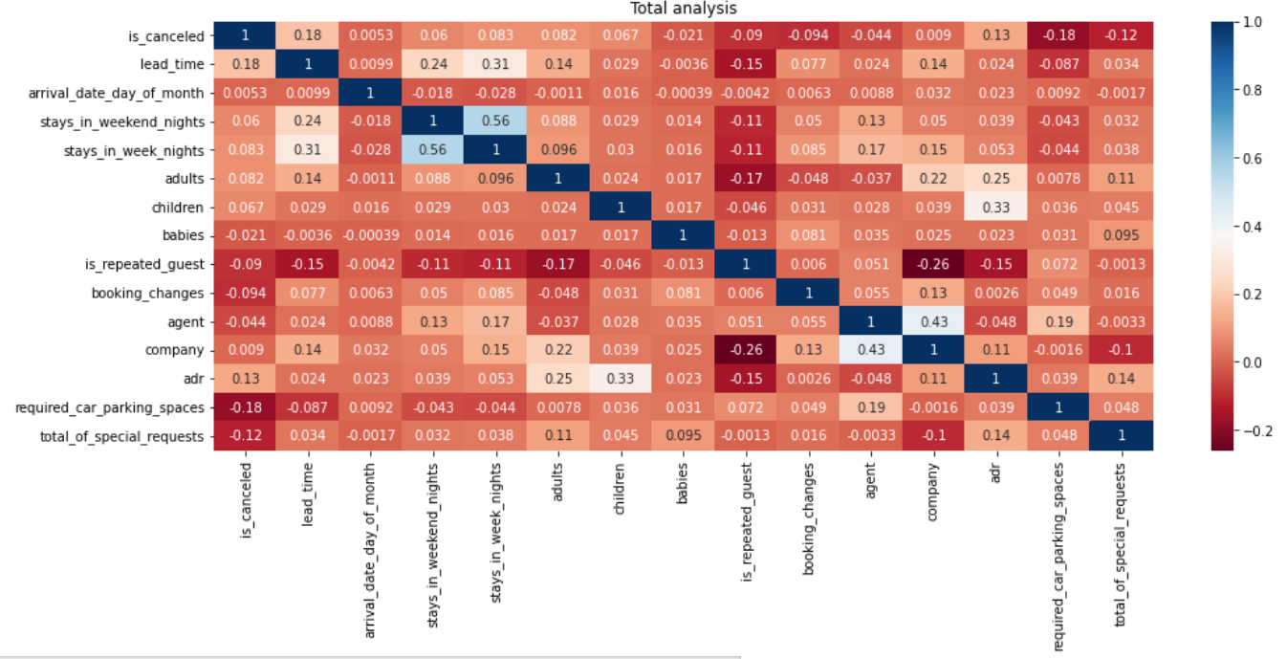
EDA of all Total numerical data of given data set:
The blue colour shows the highest probability of the column feature’s influence with respect to that of the row feature in correlation matrix.
E.g.: cancellation of bookings mainly influenced by ‘Lead time’ and ‘adr’(Average daily rate)

Slide 31
Conclusion:
Around 61% bookings are of City hotel and 39% bookings are of Resort hotel, therefore City hotels are busier than the Resort Hotels.
Around 27% of total bookings are cancelled, in that 66.6% cancellations are happening in City hotels.
In both resort and city hotels most of the bookings are happening in "PTR(Portugal)" country. we can also observe that the maximum people are preferring city hotels compared to Resort Hotels.
Most of the city and resort bookings are happening in the month of August. Followed by July. Least bookings are happening in the month of January, November and December.
The Resort hotels are getting highest revenue in the month of 'august', 'july' and then decreasing drastically. City hotel's revenue is almost constant all over year.
Maximum bookings are happening in 9th and 12th week of every year.
78% of Hotel Bookings are happening on 'BB' meal type i.e., 'BB: Bed & Breakfast'.
Most demanded room types are A next comes D and least demanded are of room type P and L.
Probability of room allocation for the customer choice reserved type A is in the order - A, K, I, C, B.

Slide 32
Conclusion (continued.....):
High probability of lead time taken is '0' i.e., immediate booking are happening but high leadtime taken is in the b/w 11th - 18th weeks of the year. Hence, this time is the busiest time of the year.
The maximum lead time taken in bookings is in the year 2016.
Majority of people stay or do a booking of 5 or less than 5 days. Now, we can say the optimal length of stay to get best daily rate is '5' for week nights and '2' for weekend nights.
Max night bookings are happening in the city hotels in weekdays and the max length of stay is 1 to 2 days.
Through TA/TO distribution channels, bookings happened with high lead time i.e, they are booking early compare to other distribution channels.
As (Average daily rate) ADR is the revenue determining factor 'GDS distribution channel' of city hotel bookings are achieving high adr (revenue).

Slide 33
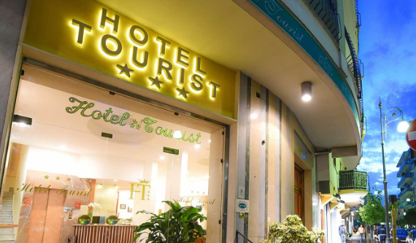

STRENGTHENING TOURISM SECTOR
During covid 19, tourism sector has hit its lowest .So the revival of tourism sector not only help in revenue generation in that sector only but also help the economy overall.
In this analysis each and every aspect has been analyzed properly
For this various things has been taken into consideration to improve the revenue generation in the hotel industry.

Slide 34


